Slide 1
Name the colleges and one thing they have in common…
Notes:
Grand Valley, Hope, State, Michigan
All are a four year univeristy
Hope and GV are on the west side of the state
Hope and Michigan require the common app
State and Michigan are big ten schools
State and Michigan highly competitive.
The list goes on…...

Slide 3
Name a college that…
…doesn’t require you to take the ACT or SAT to get in.
Notes:
Mott, Baker, Lansing Community, Oakland Community

Slide 4
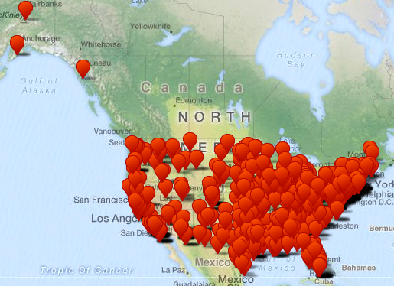
There are around 850! go to www.fairtest.org to see the full list

Slide 5
Name two colleges…
…where you only take one class at a time for three week blocks!
Notes:
Did you know that colleges even did that? Colleges run on a variety of schedules, semesters, terms, blocks. They are different sizes, have a different feel when sitting on their campus. They are just plain different. You need to explore them through research and through visits to really get a feel for a given college. Each college handles admissions, financial aid, housing, etc differently. It’s in your best interest to get to know the college and what they want.

Slide 7
Know any schools that are…
…Tuition free?
Notes:
Some colleges are tuition free but admissions are highly competitive and often have a catch, like a commitment to a given number of years serving in the military after graduation.

Slide 8
And all 5 of the U.S. Military Academies
Notes:
The cost of college is an important factor when choosing a school. But, did you know that a private college may actually end up costing you less money than one of the public colleges. The actual cost of attending can’t be determined until you apply and the college sends you an award letter. So, don’t limit your choices to the least expensive schools. They may actually cost you more in the end.

Slide 9
TOP 10 THINGS YOU NEED TO KNOW
INSIDER INFORMATION
Planning for college

Slide 10
1. Know yourself
Finding the right college for you is a journey
The journey is more important than the destination
The better you understand yourself, your unique strengths and the things you care about, the easier it will be to identify colleges that fit you
Notes:
What are your academic interests? What courses have you enjoyed the most?
How do you learn best? Is there a type of teaching style you particularly enjoy?
Which of your extracurricular interests means most to you? Why?
What accomplishment are you proudest of? Why?
How would your friends and teachers describe you and your role in the school community?
How has the environment in which you’ve grown up helped/hindered you?
What balance of study, activities and social life suits you best? How well do you respond to academic pressure and competition?
How would you feel about going to a college where other students were very different from you? Would you find it exciting or intimidating?
If you had a year to go anywhere and do whatever you wanted, how would you spend that year?

Slide 11
Self Exploration Activities
Interest/Strength Inventories – CAREER CRUISING
Job shadows
Informational interviews
GCI
Dual enrollment at local colleges
Summer opportunities offered at local colleges
Notes:
You‘ll be updating your EDP with Ms. Pennell again this year. This can be a valuable tool and give you great information if you let it. Take the time to really look at the information being presented to you and look for opportunities to explore interests outside of school. These may be in the form of doing a job shadow or sitting down with someone to ask them questions about their job and what it took to get where they are today. Consider exploring option at the GCI and maybe take a dual enrollment class if you want to explore a career area that does not have a course not offered at LHS or or GCI. Also watch for summer opportunities for career exploration through college camps.

Slide 12
2. Know the landscape
There are nearly 4,000 colleges and universities in the U.S. alone
More and more students are choosing colleges outside the U.S.
Colleges are becoming more and more selective
Every school has its own personality
Many FACTORS to consider…
Notes:
Do you prefer a large university or a small liberal-arts college?
Would you be comfortable in large lecture classes, or is it important to be known by your professors?
Do you want to know most of the other students on campus, or do you prefer some anonymity?
Do you want to stay close to home, able to see family and friends on a regular basis, or do you want to experience a different part of the country?
Do you prefer to be close to a city, in a “college town” where the college or university is the major employer and source of culture, or at a rustic campus separated from civilization?
Will you be more comfortable in a school where most of the students are interested in ideas and learning, a school where most students are grade-conscious and work hard, or a school where students do enough to get by and are primarily interested in having a good time?
Do you want a school that is politically conservative? Politically correct? Politically apathetic?
Do you want a college or university where most students live on campus, or do you want the freedom to live in an apartment off-campus after your freshman year?
How important to your college experience is varsity athletics? How important are fraternities and sororities?
Would you rather attend a college where you are fortunate to be admitted, where your credentials place you in the middle of the student body, or where your credentials qualify you for honors programs or merit scholarships?

Slide 13
3. Your high school classes will open or close doors to college
4 years of math
4 years of English
3-4 years of a lab sciences
3 years of social science
2-4 years of world languages
*most importantly, choose to take courses that challenge you (Honors, AP, Dual Enrollment)
Notes:
The reps from both U of M and Michigan State said they’d rather see a student take an AP class than dual enroll since they know the rigor of an AP class.
They also said they wouldn’t give credit for a dual enrollment class unless it was taught on campus and must be taught by a college professor.

Slide 14
What does your transcript look like?
Notes:
Did you have a good freshmen year academically? If not, you can still turn things around. Colleges will look at the trend of your grades. Have they improved and do they continue to improve? That speaks volumes.

Slide 15
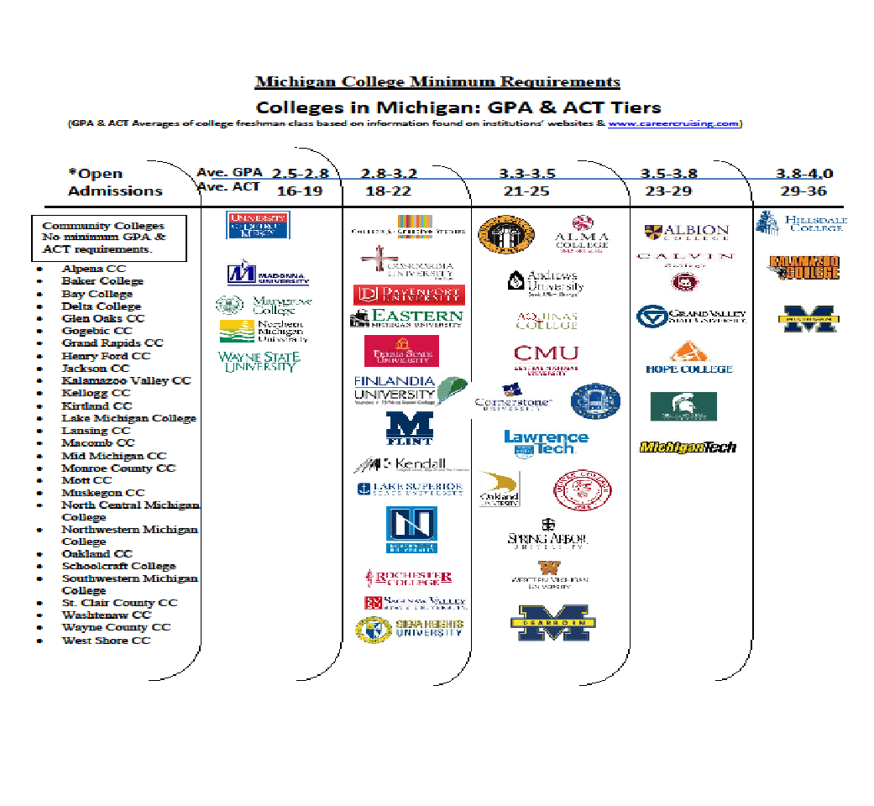

Slide 16
4. Spend your time wisely
What are you doing when you’re not in class or studying?
What you spend your time doing will demonstrate to colleges what you value

Slide 17
Extracurricular Activities
Focus on two or three that interest you
Ones that you find personally rewarding
Ones that provide a change of pace from your studies
The nature of the commitment is what is most important, not the number of activities

Slide 18
5. Spend your summers wisely
Look under the Opportunities tab on our Counseling Corner page for summer programs the HS knows about.
Search online for opportunities

Slide 19
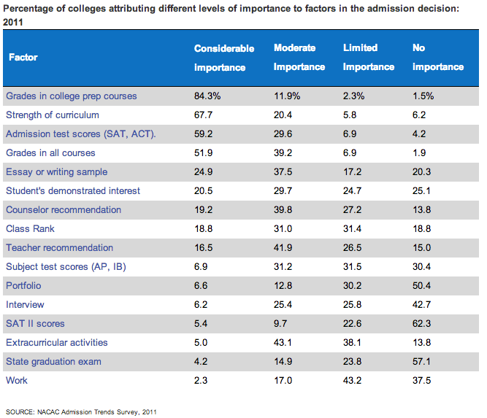
6. Know the factors that get you in
Percentage of colleges attributing different levels of importance to factors in the admission decision: 2011

Slide 20
7. Know how to prepare for Standardized Testing
Many colleges, universities and scholarships require either the ACT or SAT
There are many prep opportunities
PSAT (October); you can take it every year
Variety of free online practice tests
Khan Academy SAT test prep

Slide 21
8. Know the best sources for college research
This process should be the culmination of doing several “getting to know yourself” activities
Career Cruising

Slide 22
Three types of fit
The Trifecta:
•Academic Fit
How do you match academically?
•Campus Culture Fit
What type of school is a good fit for you?
•Financial Fit
What do you know about the cost? Do you know the NET PRICE vs. Sticker Price?

Slide 23
9. Visit, Visit, Visit
This is best way to uncover “insider” information and learn the uniqueness of each school
Spring of Sophomore and Junior Year is the best time to visit
Consider visiting at least 3 colleges
To set up a campus visit, you must go to the college/university website
You are allowed two excused college visits per year- bring back a note from the college for it to count

Slide 24
10. Use your counselor
Schedule a meeting with your counselor if you have questions or concerns
Demonstrate that you are highly motivated
Counselors can help you make a plan and give recommendations
Counselors are your best source for helping you find “insider information”

